Slide 1


SSURGO On-Demand Dynamic Spatial Tools
Chad Ferguson and Jason Nemecek
Natural
Resources
Conservation
Service
Helping People Understand Soils
Notes:
A SSURGO On-Demand Dynamic Spatial Tools are for everyone working with soil survey interpretations and properties! Learn about the SSURGO On-Demand Toolbox and how to install and use it. These tools serve as an alternative to Soil Data Viewer and are designed to process large extents rapidly from data already served on Web Soil Survey. No external tabular data is needed and spatial data is optional. : The SSURGO On-Demand tools offer a one-stop shop for any number of Soil Survey Areas at once State, Region, watershed for any/all interpretations or properties. The SSURGO on-demand tools extend the functionality of gSSURGO and the SSURGO download tools.
Contact Information:
Charles Ferguson
Soil Scientist, Geospatial Analyst
USDA - NRCS
Mid-Atlantic and Caribbean Regional Office
4407 Bland Rd. Suite 117
Raleigh, NC 27609
Office: 919.873.2137
charles.ferguson@nc.usda.gov
Jason Nemecek
Wisconsin State Soil Scientist
USDA – NRCS
8030 Excelsior Drive, Suite 200
Madison, WI 53717
Office: 608.662.4422; 202
jason.nemecek@wi.usda.gov

Slide 2

ArcGIS tool for creating soil-based themaic Maps
Requires ArcGIS 10.1 +
Easy way to access soil data
SSURGO
OnDemand
Natural
Resources
Conservation
Service
Helping People Understand Soils
Notes:
What are the tools? The tools run in ArcGIS 10.1 or greater. Its an ArcGIS toolbox that provides a easy way for someone to access soils data.
A quick overview of two tools that facilitate the download, merging, and analysis of SSURGO datasets into LARGE regional datasets using ARCGIS: SSURGO on Demand Dynamic Spatial Tools for Soil Interpretations and Properties

Slide 3
Generates a thematic map-fast!
Tabular and/or spatial data hits Soil Data Access services
Joins interps or properties to gSSURGO or SSURGO
Introduction
Natural
Resources
Conservation
Service
Helping People Understand Soils

Slide 4
Similar to Soil Data Viewer
Works with massive data sets
Introduction
Natural
Resources
Conservation
Service
Helping People Understand Soils
Notes:
The tools are similar to soil data viewer however it can process large datasets and not really limited to one survey area. Its not limited to old data since it is hitting soil data access,

Slide 5
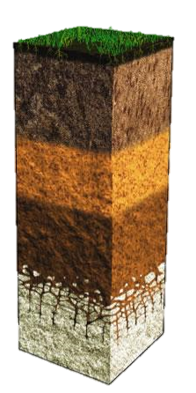
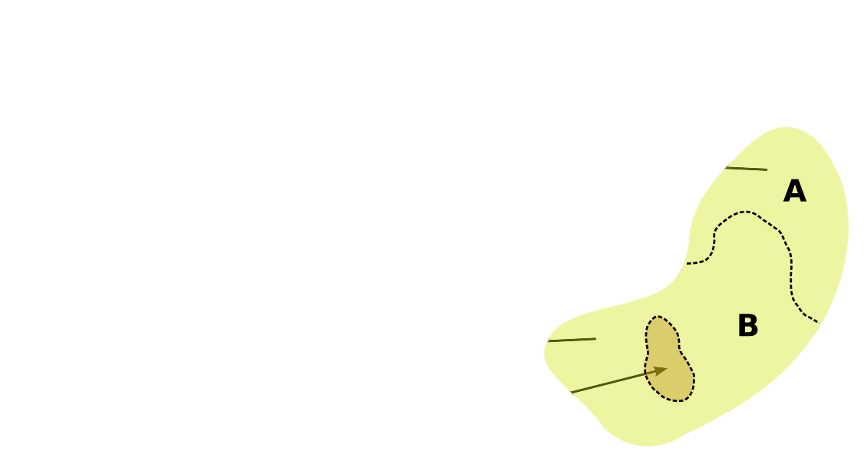
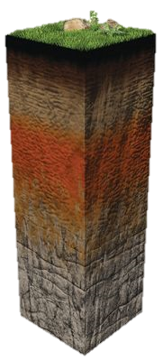
map unit polygon
major
components
horizons
How do we make sense of soils data?
minor component(s)
Natural
Resources
Conservation
Service
Helping People Understand Soils
Notes:
Soils are complex and when displaying soil data we are or we’re dealing with many to one relationships and getting the ‘best’ soil data can be difficult. The tools provide a way for us not to understand the database and its’ structure. The tools provide a way to get to the sub-table soil data and aggregate it.
How users use the soils data is extremely important
Depth
Weighted Average
Dominate Component
Dominant Condition
Minimum
Maximum
Thickest Layer
Average
Surface Horizon
Organic Horizons
Mineral Horizons
Null
No Data
Frequency
Restrictive Layers
Component Percent
Major Components
Minor Components.
All Components
Depth range
All Horizons

Slide 6
Aggregate / Interpretations
(component vs mapunit)
Numeric variables (i.e. Clay, Organic Matter)
Weighted average
Categorical variables (i.e. T-factor, HSG)
Dominant condition
Categorical or Numeric variables
Dominant component
How do we make sense of soils data?
Natural
Resources
Conservation
Service
Helping People Understand Soils
Notes:
Any use of soil data to make predictions falls under the broad category that soil scientists call “soil interpretations.” NRCS maintains a set of interpretations in the Web Soil Survey. These include calculated values, such as K and T, and features, such as Hydrologic Soil Groups and Unified Soil Classification. The interpretations also include various ratings of suitability and limitations for land uses.
Soil properties themselves can be divided into two broad categories, intrinsic soil properties and non-intrinsic soil properties. Intrinsic soil properties are those empirical soil properties that are not based on any other soil properties (very fine sand content). Non-intrinsic soil properties tend to be derived from multiple intrinsic soil properties (K-factor). Non-intrinsic soil properties tend to be interpretive in nature. Examples of non-intrinsic soil properties include Farmland Classification, T-Factor and Wind Erodibility Group (WEG).
Dominant Condition: The aggregation method "Dominant Condition" first groups like attribute values for the components in a map unit. For each group, percent composition is set to the sum of the percent composition of all components participating in that group. These groups now represent "conditions" rather than components. The attribute value associated with the group with the highest cumulative percent composition is returned. The example below the second 2 components would be the dominant condition.
Dominant Component: The aggregation method "Dominant Component" returns the attribute value associated with the component with the highest percent composition in the map unit. The result returned by this aggregation method may or may not represent the dominant condition throughout the map unit.
Weighted Average: The aggregation method "Weighted Average" computes a weighted average value for all components in the map unit. Percent composition is the weighting factor. The result returned by this aggregation method represents a weighted average value of the corresponding set classes for the map unit.

Slide 7
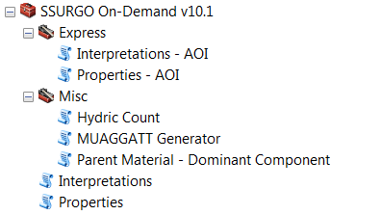
No local tabular is needed
Generates thematic interpretation maps in ArcMap by Soil Survey Area(s)
Main
Toolset
Natural
Resources
Conservation
Service
Helping People Understand Soils

Slide 8
No local tabular or spatial data is needed
Generates data from desired area
Express Toolset
Natural
Resources
Conservation
Service
Helping People Understand Soils
Notes:
The express tools require no data at all! No spatial or tabular data is needed.

Slide 9
aggregated in order to express a consolidated value or interpretation
Misc.
Toolset
Natural
Resources
Conservation
Service
Helping People Understand Soils
Notes:
Hydric Soil Categories: The Hydric Count counts all the components in the map unit and classifies the map unit based on the number of major or minor hydric components instead of using component percent.
This Hydric Soil Category rating indicates the components of map units that meet the criteria for hydric soils. Map units are composed of one or more major soil components or soil types that generally make up 20 percent or more of the map unit and are listed in the map unit name; and they may also have one or more minor contrasting soil components that generally make up less than 20 percent of the map unit. Each major and minor map unit component that meets the hydric criteria is rated hydric. The map unit class ratings based on the hydric components present are: Hydric, Predominantly Hydric, Partially Hydric, Predominantly Nonhydric, and Nonhydric. The report also shows the total representative percentage of each map unit that the hydric components comprise.
" Hydric" means that all major and minor components listed for a given map unit are rated as being hydric. " Predominantly Hydric" means that all major components listed for a given map unit are rated as hydric, and at least one contrasting minor component is not rated hydric." Partially Hydric" means that at least one major component listed for a given map unit is rated as hydric, and at least one other major component is not rated hydric. " Predominantly Nonhydric" means that no major component listed for a given map unit is rated as hydric, and at least one contrasting minor component is rated hydric. " Nonhydric" means no major or minor components for the map unit are rated hydric. The assumption is that the map unit is non-hydric even if none of the components within the map unit have been rated.
The Map Unit Aggregated Attribute records a variety of soil attributes and interpretations that have been aggregated from the component level to a single value at the map unit level. They have been aggregated by one or more appropriate means in order to express a consolidated value or interpretation for the map unit as a whole.
The Parent Material Attribute generalizes the parent material groupings into a more uniform format. It is based on the Field Guide groupings of parent material kinds

Slide 10
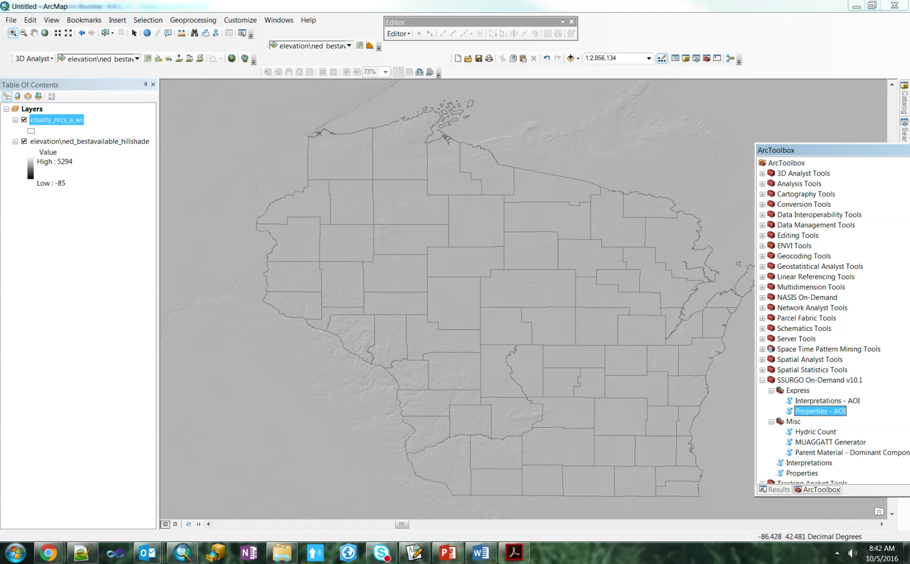
Express Toolset
Natural
Resources
Conservation
Service
Helping People Understand Soils

Slide 11
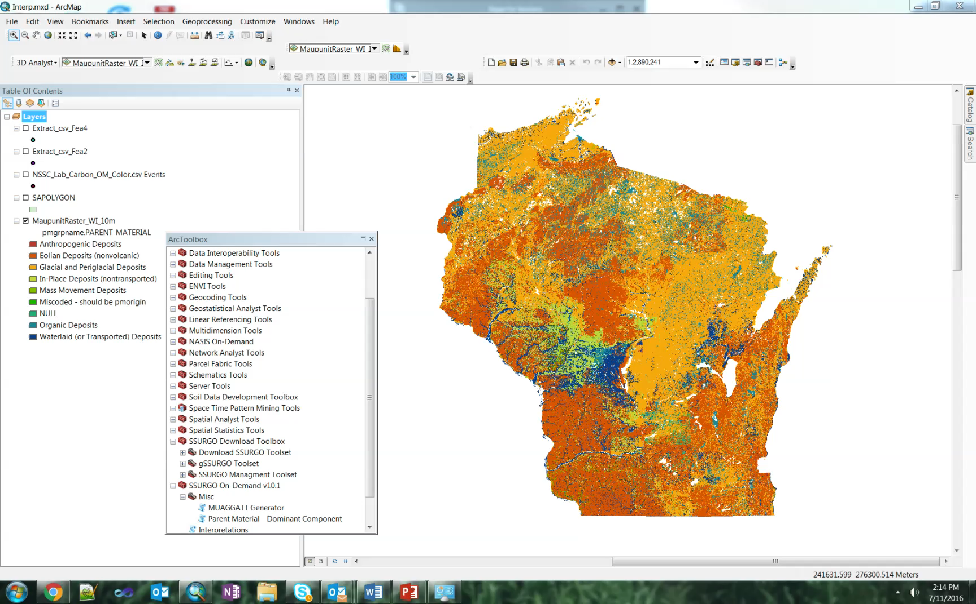
Main
Toolset
Natural
Resources
Conservation
Service
Helping People Understand Soils

Slide 12
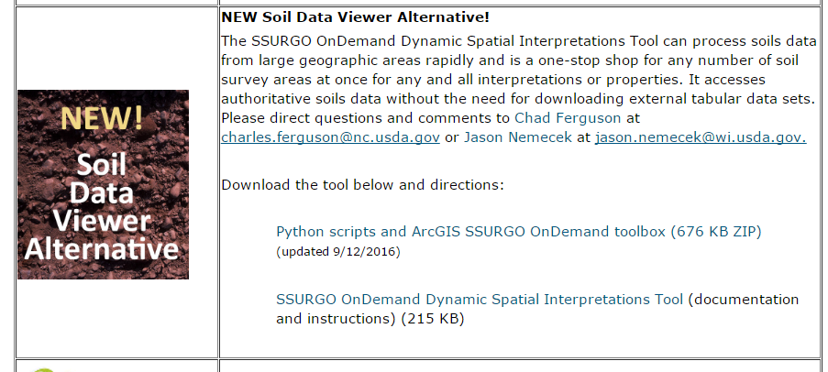
NRCS WI Soils Webpage
http://www.nrcs.usda.gov/wps/portal/nrcs/main/wi/soils/
Where can you get these tools?
Natural
Resources
Conservation
Service
Helping People Understand Soils
Notes:
We currently have the tools posted to the Wisconsin NRCS soils Webpage. If you google NRCS WI Soils it should get you to the webpage. There you will find a link to download the tools found under the “New Soil Data viewer alternative”

Slide 13

Questions
Natural
Resources
Conservation
Service
Helping People Understand Soils
Notes:
Any Questions?

Slide 14
USDA is an equal opportunity provider, employer and lender
Natural
Resources
Conservation
Service
Helping People Understand Soils

